Slide 1

Let’s start with Allah Yaar
Bs in Computer Science

Slide 2
Network Issues and Communication
Latency:
Defined as the time it takes for data to travel from the sender to the receiver.
Measured in milliseconds (ms) and affects applications like video streaming, online gaming, and VoIP.
Factors Causing Latency: Distance between devices (e.g., international communication).
Type of network (wired is often faster than wireless).
Server response times.

Slide 3
Network Issues and Communication
Solutions to Reduce Latency: Use Content Delivery Networks (CDNs).
Implement caching strategies.
Optimize routing and network paths.
Bandwidth Limitations:
Refers to the maximum amount of data that can be transmitted in a specific time, often measured in Mbps or Gbps.
Impact of Low Bandwidth:
Slow downloads, buffering in videos, and reduced quality in video calls.
Inability to handle multiple simultaneous users.

Slide 4
Network Issues and Communication
How to Manage Bandwidth: Implement Quality of Service (QoS) protocols to prioritize critical traffic.
Upgrade network infrastructure or adopt fiber-optic connections.
Packet Loss:
Happens when one or more packets of data fail to reach their destination.
Causes:
Network congestion, faulty hardware, or signal interference.
Weak Wi-Fi signals or poor cabling.
Effects: Corrupted data, interruptions in streaming, and retransmission delays.
Mitigation Strategies:
Use error correction protocols like TCP.
Regularly maintain network hardware.

Slide 5
Network Issues and Communication
Mitigation Strategies:
Use error correction protocols like TCP.
Regularly maintain network hardware.
Interference:
Particularly relevant to wireless networks like Wi-Fi and Bluetooth.
Sources of Interference
Nearby electronic devices, physical obstructions like walls, or overlapping frequency channels.

Slide 6
Network Issues and Communication
Ways to Minimize Interference
Use modern equipment that supports dual-band or tri-band Wi-Fi.
Optimize channel selection and device placement.
Security Concerns
Unauthorized access to networks can lead to data theft or service disruptions.
Prevention Measures
Use firewalls and secure routers.
Apply strong encryption protocols like WPA3 for wireless networks.

Slide 7
Network Issues and Communication
Network Configuration Issues
Incorrectly configured devices can result in downtime or inefficient communication.
Best Practices
Document all configurations for routers, switches, and firewalls.
Use automated configuration management tools to prevent errors.

Slide 8
Security Issues Regarding Data Transfer
Eavesdropping
Involves unauthorized interception of data in transit, often on unencrypted networks.
Examples
Hackers intercepting login credentials over public Wi-Fi.
Passive monitoring of unsecured network traffic.
Countermeasures
Always use encrypted connections (e.g., HTTPS, VPN).
Avoid transmitting sensitive data on public networks.

Slide 9
Security Issues Regarding Data Transfer
Man-in-the-Middle Attacks
An attacker secretly intercepts and possibly alters communication between two parties.
How it Happens
Through fake Wi-Fi hotspots or ARP spoofing.
Protection Strategies
Use digital certificates and encrypted protocols like SSL/TLS.
Enable DNS security extensions (DNSSEC).

Slide 10
Security Issues Regarding Data Transfer
Data Integrity Threats
Ensuring that data sent is identical to what is received is critical.
Vulnerabilities
Data alteration during transmission, intentional or accidental.
Mitigation Techniques
Use cryptographic hashing functions like SHA-256.
Employ message authentication codes (MACs).

Slide 11
Security Issues Regarding Data Transfer
Encryption
Converts data into a format that can only be read by the intended recipient.
Examples of Encryption Protocols
AES (Advanced Encryption Standard).
TLS (Transport Layer Security) for internet communications.
Importance
Prevents unauthorized access, even if data is intercepted.

Slide 12
Security Issues Regarding Data Transfer
Secure Protocols
Designed specifically to ensure safe data transfer.
Examples
HTTPS for secure web traffic.
FTPS for file transfers.
VPNs to create private, secure communication channels.

Slide 13
Passwords
Strength of Passwords
Secure passwords should be at least 12 characters long, with a mix of uppercase, lowercase, numbers, and symbols.
Weak Password Examples: “password123” or personal information like birth dates.
Risk of Weak Passwords: Easily cracked by brute-force attacks or dictionary attacks.

Slide 14
Passwords
Password Management
Storing and remembering unique passwords for every account is impractical without tools.
Tools: Dashlane, LastPass, or Bitwarden.
Features:Auto-fill functionality, encrypted password storage, and breach monitoring.

Slide 15
Passwords
Two-Factor Authentication (2FA)
Requires two independent factors to verify identity.
Example: A password plus a code sent via SMS or a fingerprint scan.
Common Mistakes
Writing passwords on paper.
Sharing credentials with others.
Using the same password across multiple platforms.

Slide 16
Other Authentication Methods
Behavioral Biometrics
Tracks behavioral patterns, like typing speed or voice recognition, to identify users.
Advantages
Adds an invisible layer of security.
Multi-Factor Authentication (MFA)
Combines two or more methods (e.g., a password and a biometric scan).
Strengths: Highly secure compared to single-factor authentication.

Slide 17
Other Authentication Methods
Public Key Infrastructure (PKI)
Uses digital certificates to ensure the authenticity of users or devices.
Applications: Encrypted emails, digital signatures, and secure websites.

Slide 18
Anti-Malware Software
Types of Malware
Viruses: Infect files and spread to other systems.
Worms: Self-replicate and spread without user action.
Ransomware: Locks files and demands payment for access.
Spyware: Secretly collects user information.
Adware: Bombards users with unwanted ads.

Slide 19
Anti-Malware Software
Functions of Anti-Malware Software
Real-Time Protection: Detects threats as they occur.
Scanning and Removal: Locates and removes existing malware.
Heuristic Analysis: Identifies new malware by analyzing behavior patterns.

Slide 20
Anti-Malware Software
Importance of Updates
Regular updates ensure that anti-malware can counter the latest threats.
Example: Protection against zero-day attacks.
Firewall Integration
Works alongside anti-malware to block unauthorized traffic.

Slide 21
Electronic Conferencing
Platforms
Tools like Zoom, Microsoft Teams, or Google Meet offer a range of conferencing solutions.
Special Features : Virtual backgrounds, breakout rooms, and integrations with other apps.
Key Features
Video and Audio Calls: High-quality options for face-to-face interactions.
Screen Sharing: Allows presenters to demonstrate directly from their device.
File Sharing: Real-time distribution of documents.

Slide 22
Electronic Conferencing
Recording: Enables post-meeting review or documentation.
Security Concerns
Risks
Unauthorized access to meetings (e.g., “zoom-bombing”).
Leaks of sensitive discussions.
Countermeasures
Enable meeting passwords and waiting rooms.
Use end-to-end encryption.

Slide 23
Electronic Conferencing
Impact on Productivity
Facilitates global collaboration, reduces travel costs, and allows remote working.

Slide 24
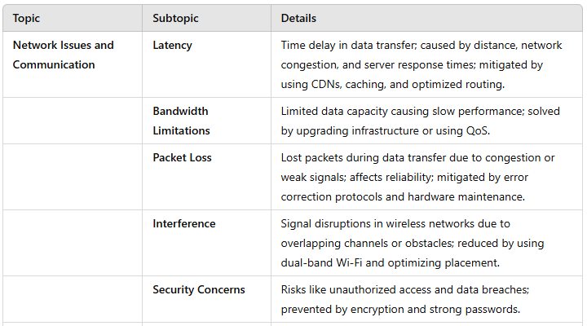
Summary Table

Slide 25
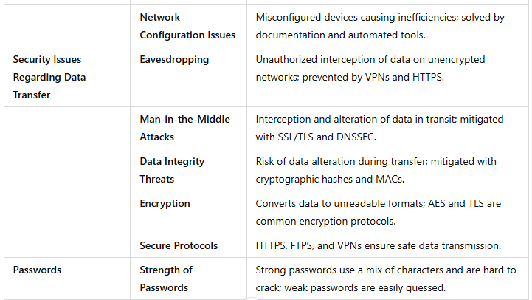
Summary Table

Slide 26
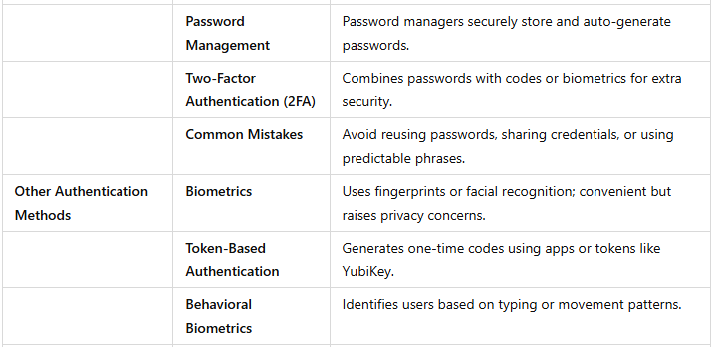
Summary Table

Slide 27
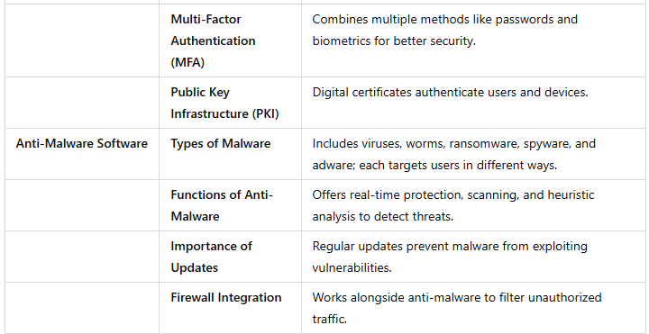
Summary Table

Slide 28
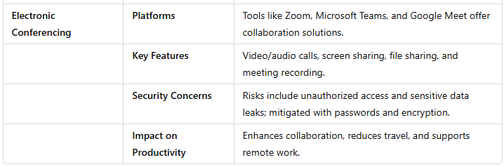
Summary Table

